Slide 1
Forecast Techniques
OTI JAMES

Slide 2
The Forecast Process
Data Collection and Monitoring
Data Processing and Manipulation
Forecast Products

Slide 3
NUMERICAL WEATHER PREDICTION
Statistical models and current weather conditions
Past and present weather events
Equations and algorithms(around air flow) are used to generate models

Slide 4
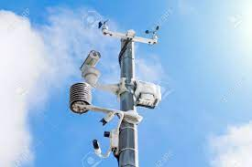


Stage 1
Data collection and Validation
Stage 2
Data transmission through GTS
Stage 3
Use of algorithms to generate forecast products

Slide 5
Forecast Types
Marine Forecast
Aeronautical Forecast
Public Weather Forecast

Slide 6
Forecasting Products
Pressure
Wind at different pressure levels
ITB

Slide 7
Pressure
High or low pressure is defined by the area around it
Air warms, rises leading to low pressures
Air cools, descends leading to high pressures
High pressure – settled / stable weather
Descending winds reduces formation of clouds
Low pressure – unsettled / unstable weather
Ascending moist winds cools, water vapor condenses and leads to cloud formation

Slide 8
What to look for on Pressure Charts
High Pressure Areas
Low Pressure Areas
Ridges
Trough
Pressure Tendency
Pressure Gradient

Slide 9
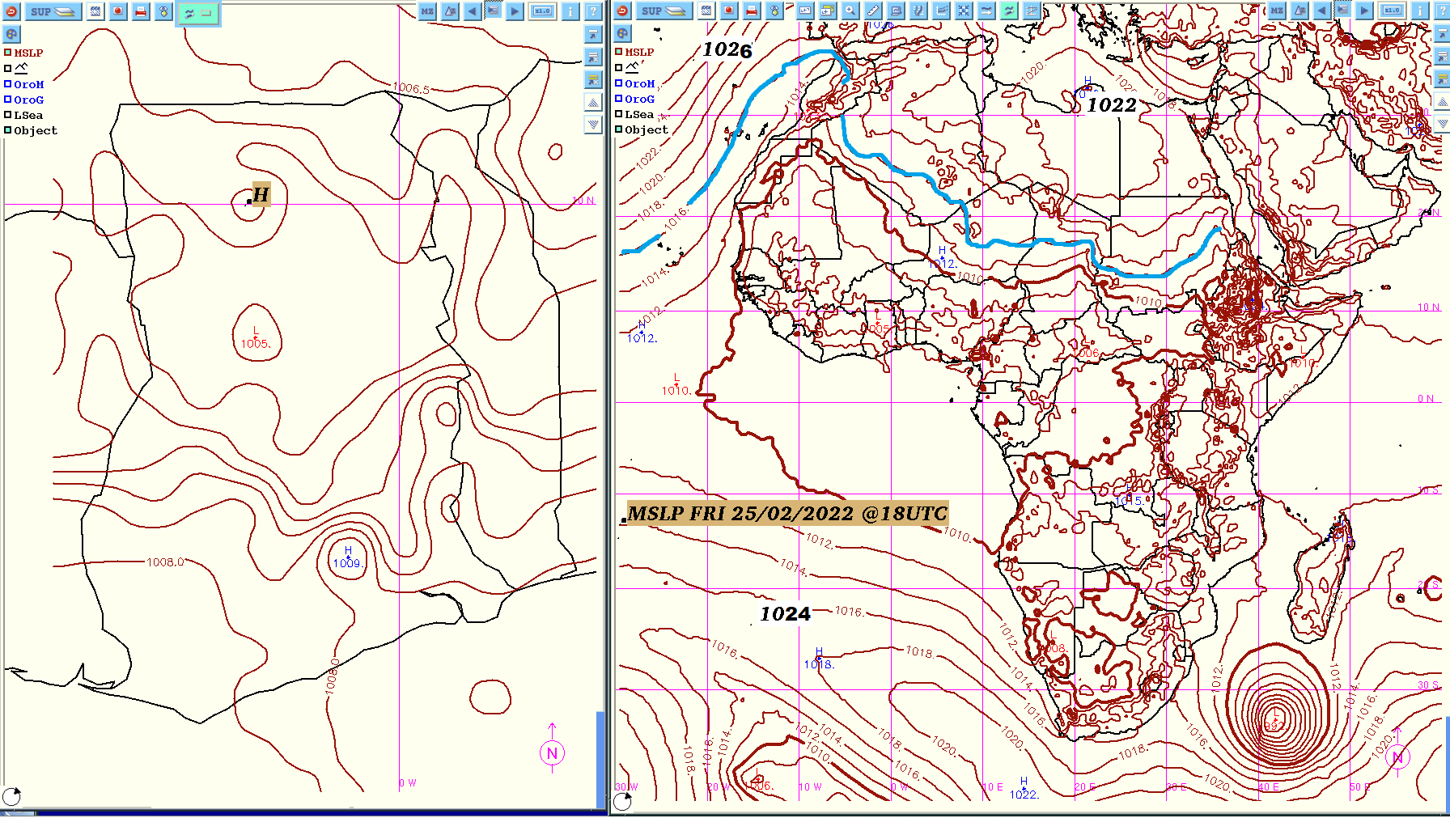

Slide 10
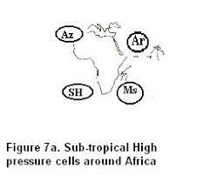

Slide 11


Slide 12
Pressure Charts
https://apps.ecmwf.int/webapps/opencharts/products/medium-mslp-wind850?base_time=202110040000&projection=opencharts_africa
https://www.cpc.ncep.noaa.gov/products/international/cpci/data/00/fcsts_wafrica.shtml
https://wxcharts.com/?panel=default&model=gfs,gfs,gfs,gfs&region=north_africa&chart=mslp,850temp,wind10mkph,snowdepth&run=06&step=000&plottype=10&lat=5.557&lon=-0.201&skewtstep=0

Slide 13
Wind Charts
Cyclonic Vortices or flows
Anticyclonic Vortices or flows
Source of Wind
Direction and Speed of the Wind
Directional or Velocity Convergence
Diverging winds

Slide 14
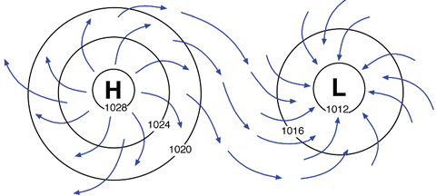
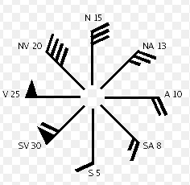
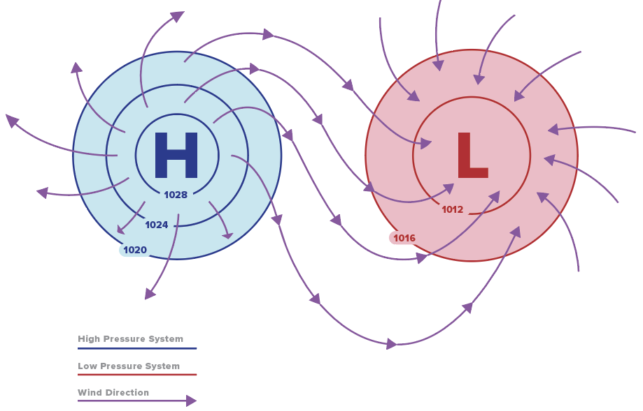
Wind Dynamics

Slide 15
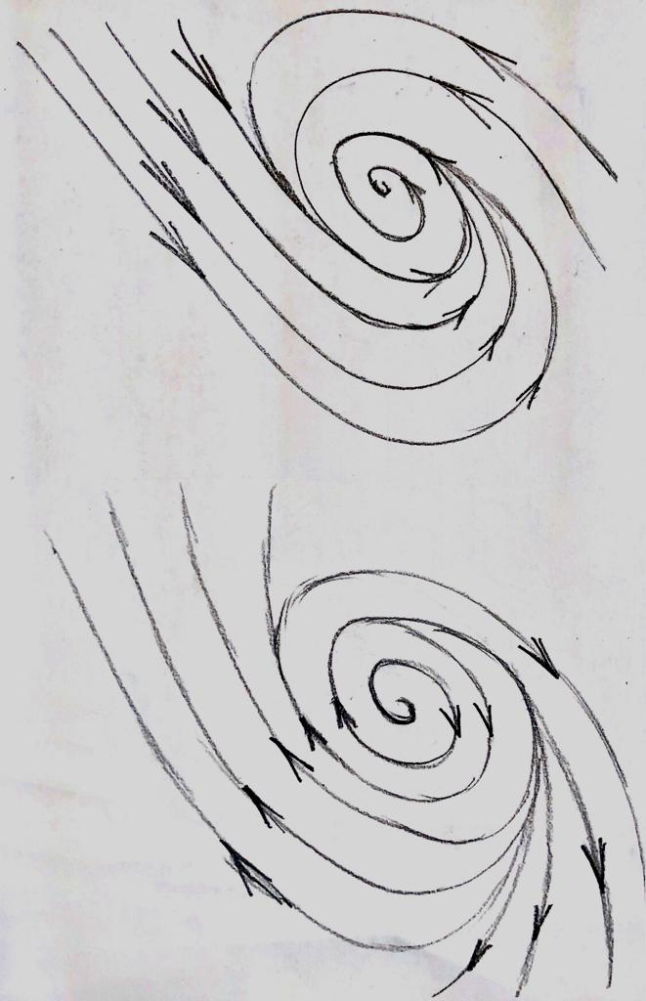
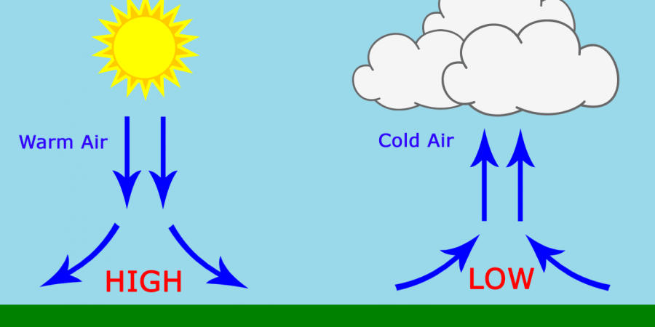
Cyclonic and Anticyclonic
C
A

Slide 16
Winds at Standard Pressure Levels
925 hPa
850 hPa
700 hPa
600 hPa
200 hPa
100 hPa
Low levels
Mid levels
High levels

Slide 17
Low Levels
Source of wind
Wind direction
Wind speed
Convergence – Direction or Velocity
Cyclonic flows
Anticyclonic flows

Slide 18
Mid Levels
Wind direction
Wind speed
Cyclonic flows
Anticyclonic flows

Slide 19
High Levels
Wind direction**
Wind speed**
Cyclonic flows
Anticyclonic flows

Slide 20
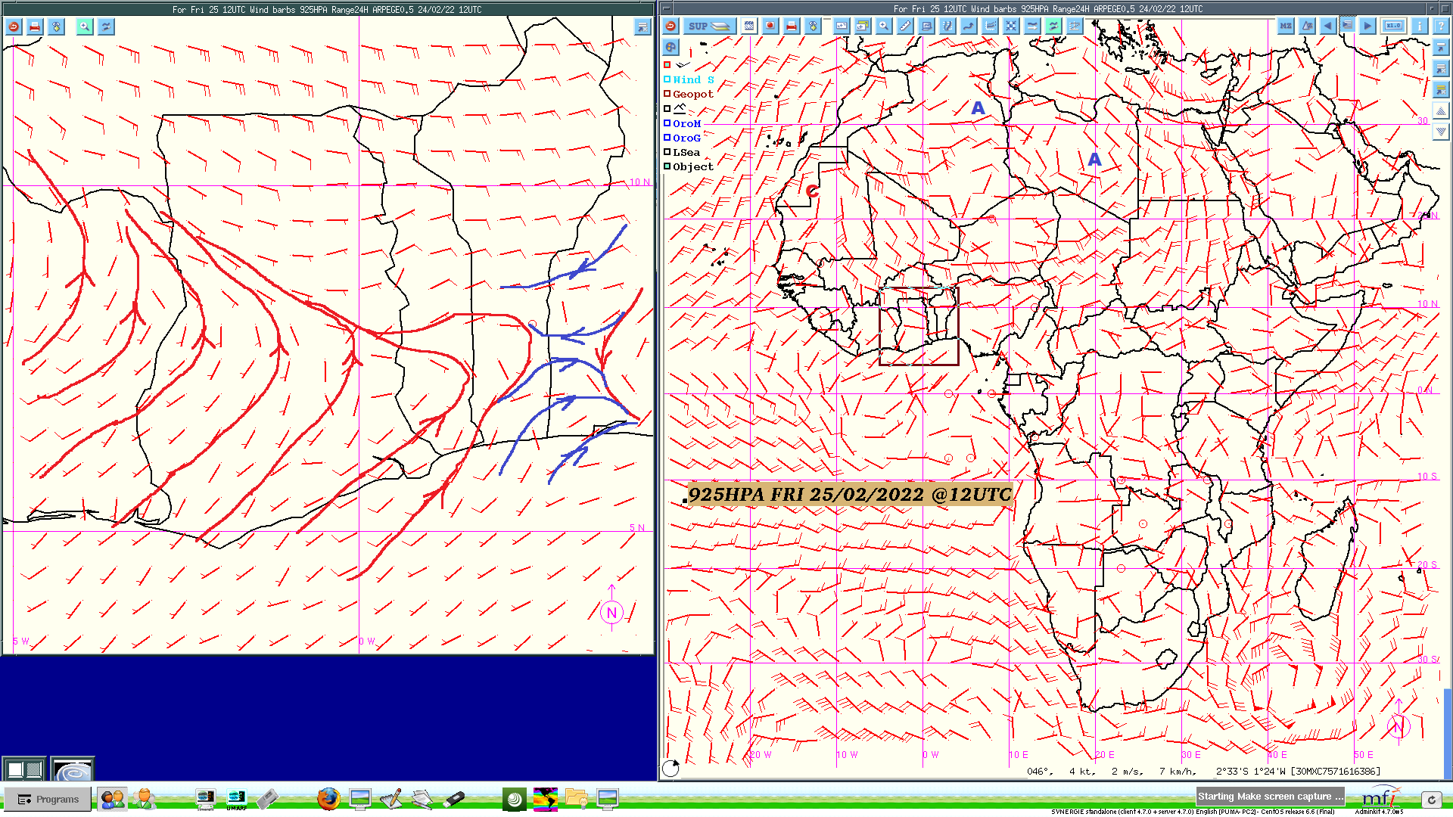

Slide 21
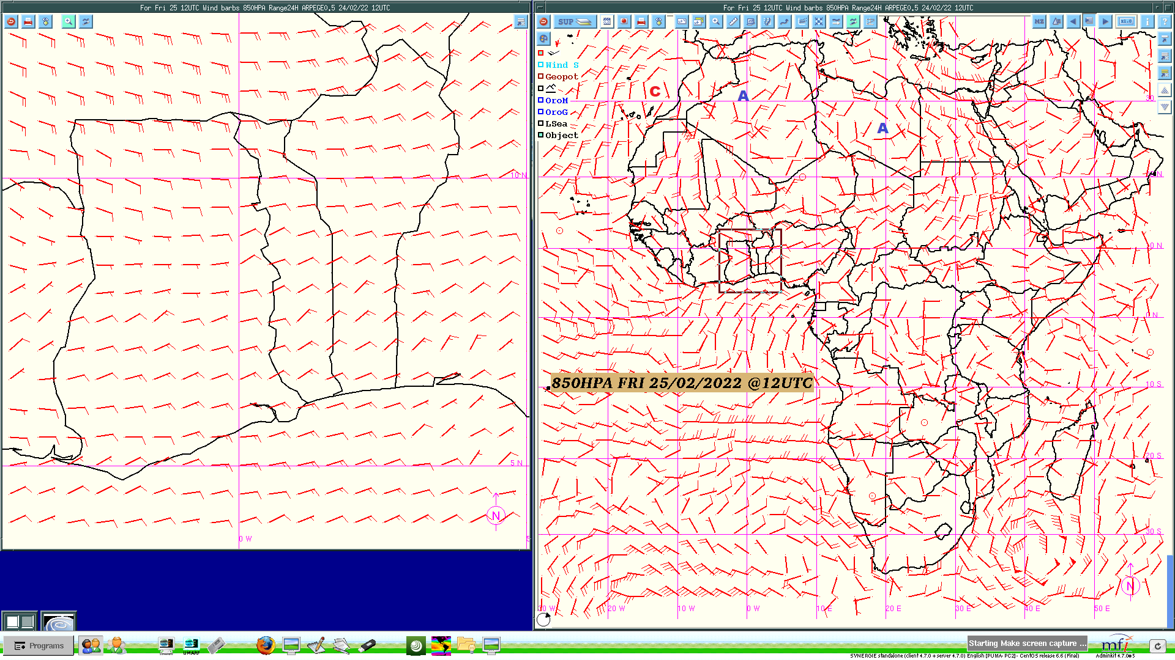

Slide 22


Slide 23
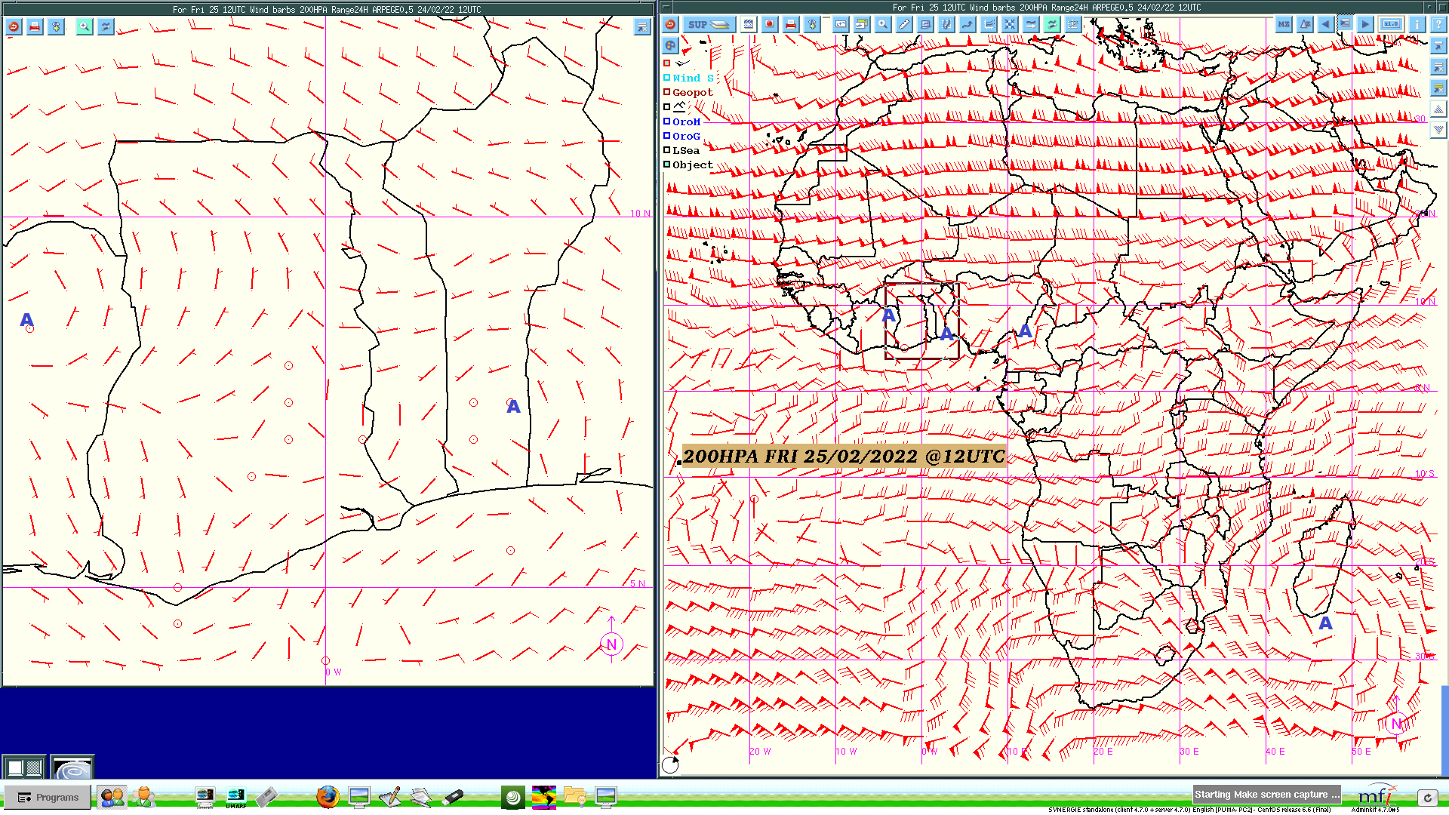

Slide 24
Take Homes
Low level | Mid level | Description
Convergence | Convergence | Deep convergence
Convergence | Divergence | Shallow convergence
Low level | Mid level | High level | Inference
Cyclonic | Cyclonic | Anticyclonic | Unstable
Cyclonic | Anticyclonic | Anticyclonic | Conditionally unstable
Anticyclonic | Anticyclonic | Cyclonic | Stable
Cyclonic | Cyclonic | Cyclonic | Unstable

Slide 25
Worthy Pointers
Diurnal Variation in Pressure
African Easterly Wave
Daily Temperature changes
Temperature Inversion
Moisture depth

Slide 26
ITB
Estimated position of the ITB
° 15°C dew point temperature / Surface winds
° Line of symmetry through troughs
° Satellite images
Weather zones of the ITB
Rate of increase or decrease from previous position or subsequent estimates.

Slide 27
Satellite Monitoring
Type of channel
Time of Day and feature to look for
Season
NB: Always animate satellite images

Slide 28
Satellite Channels
Primary or Basic Channels
RGBs

Slide 29
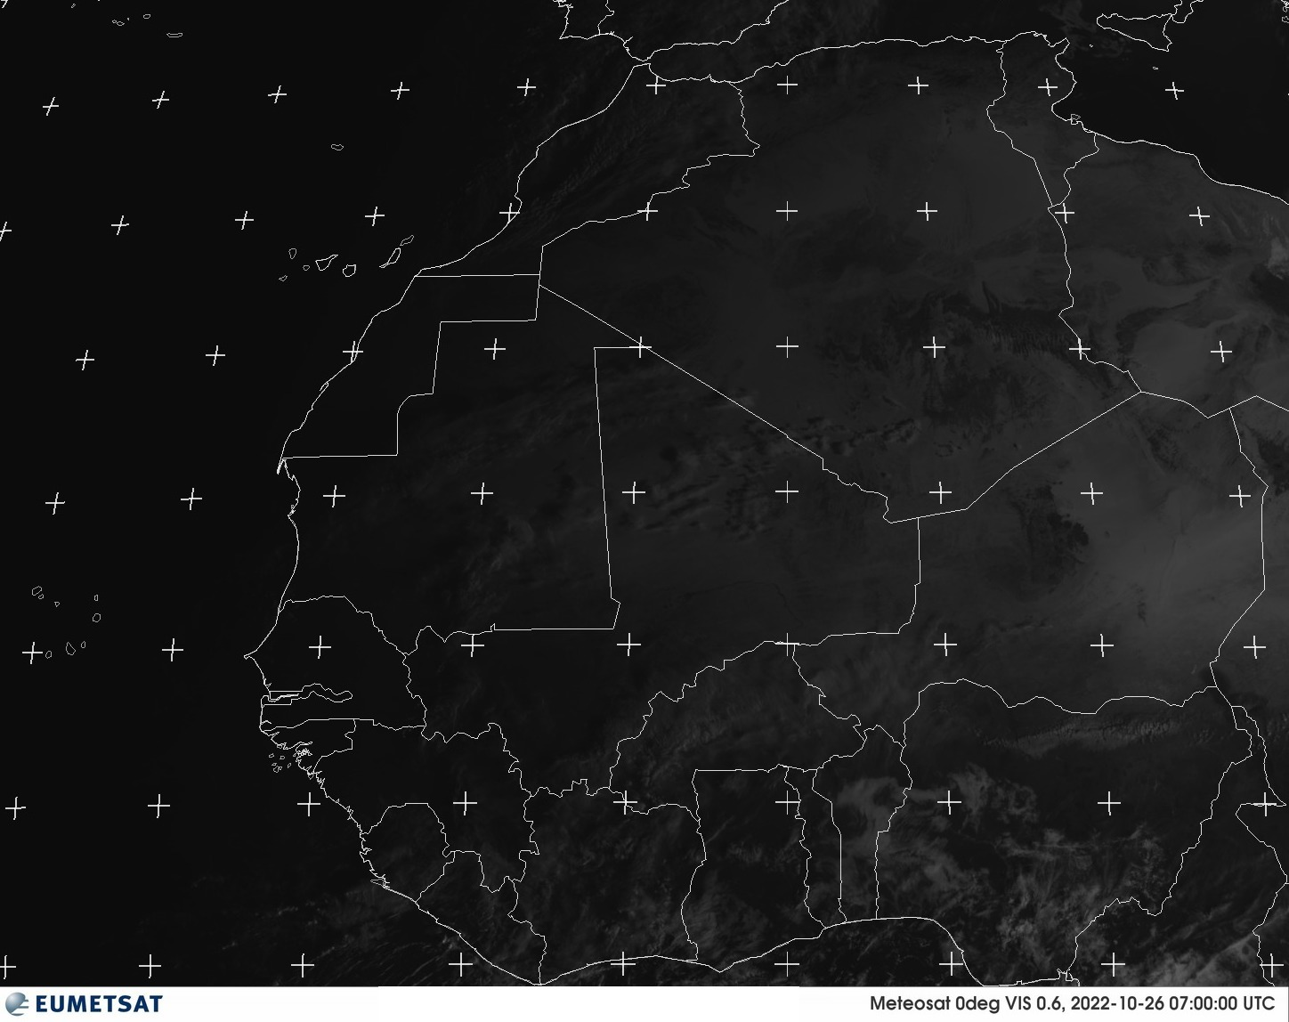
Visible

Slide 30
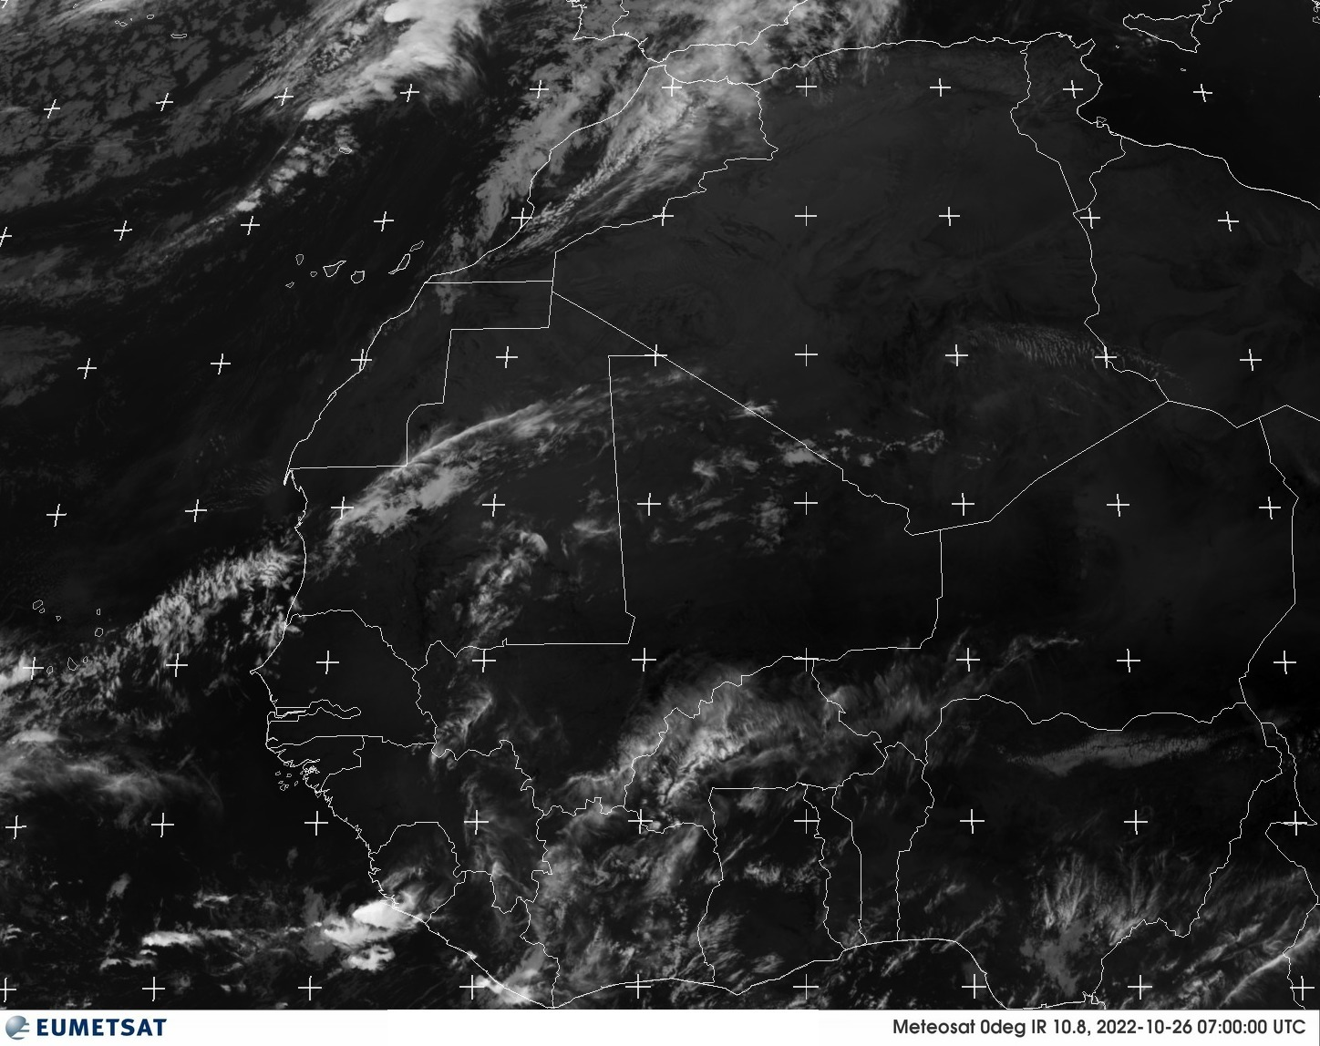
Infrared

Slide 31
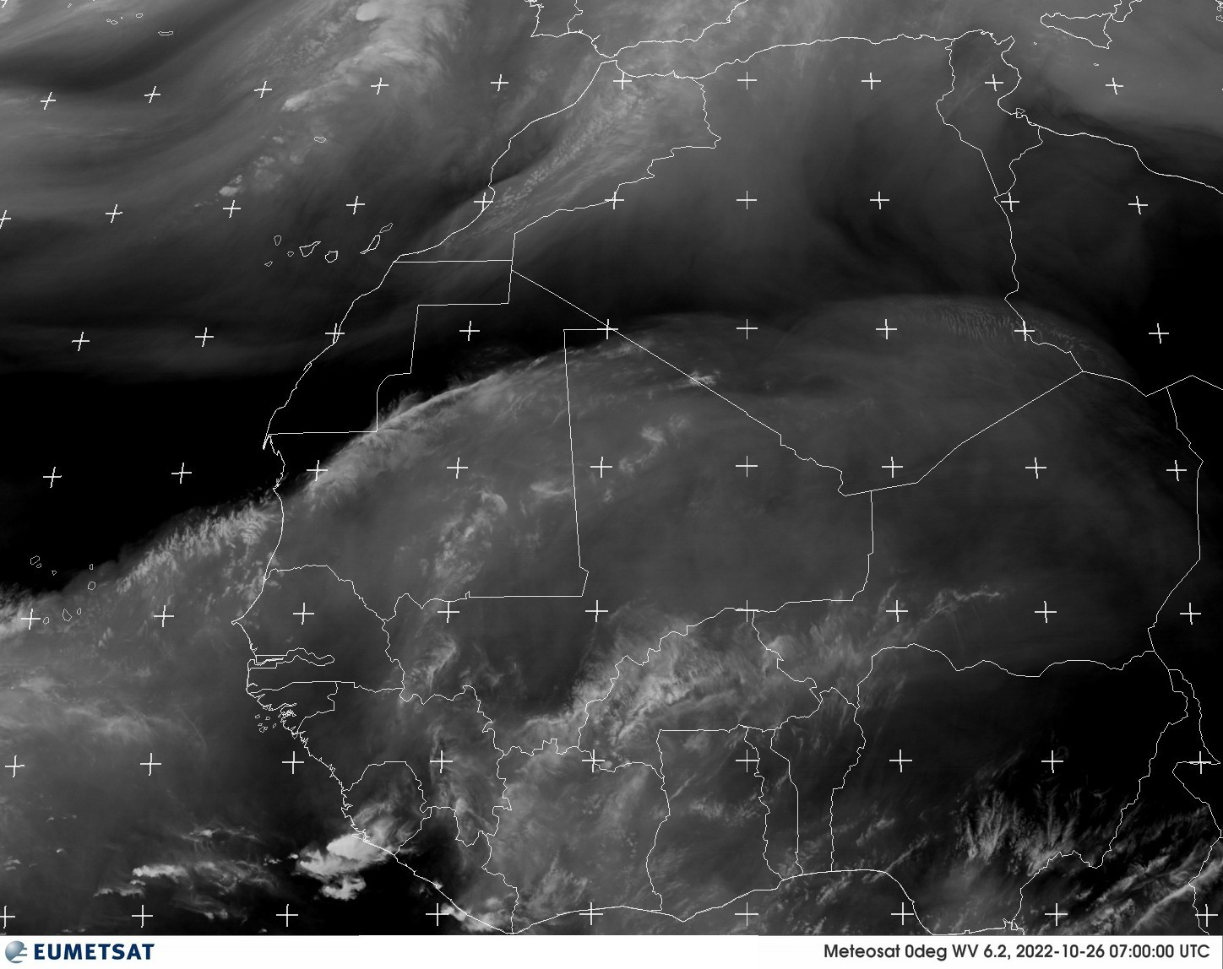
Water Vapor

Slide 32
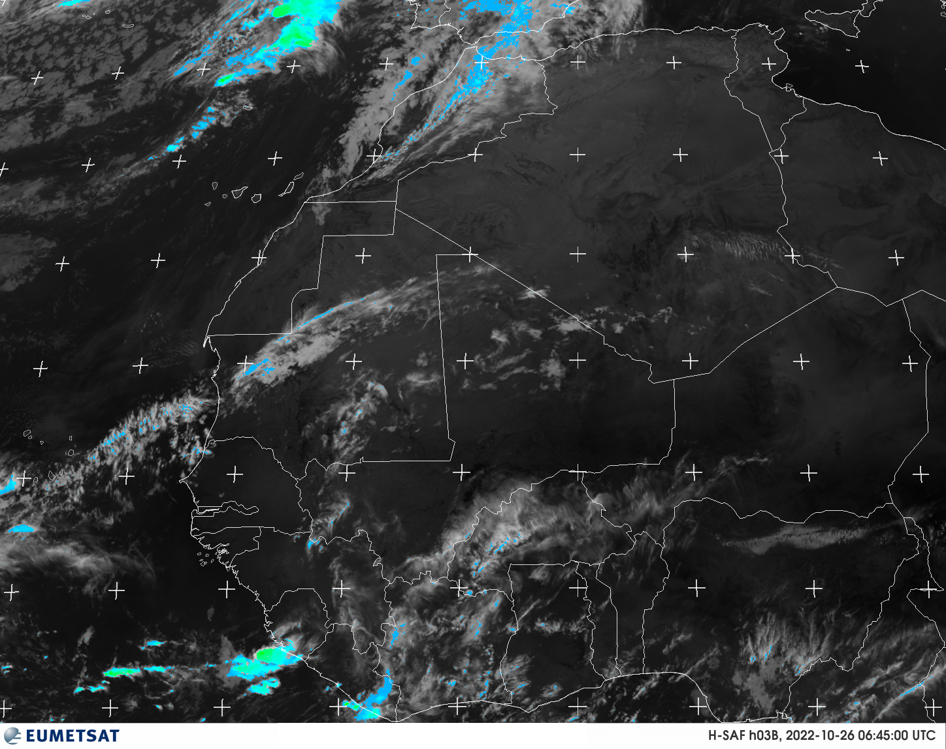
H-SAF HO3B

Slide 33
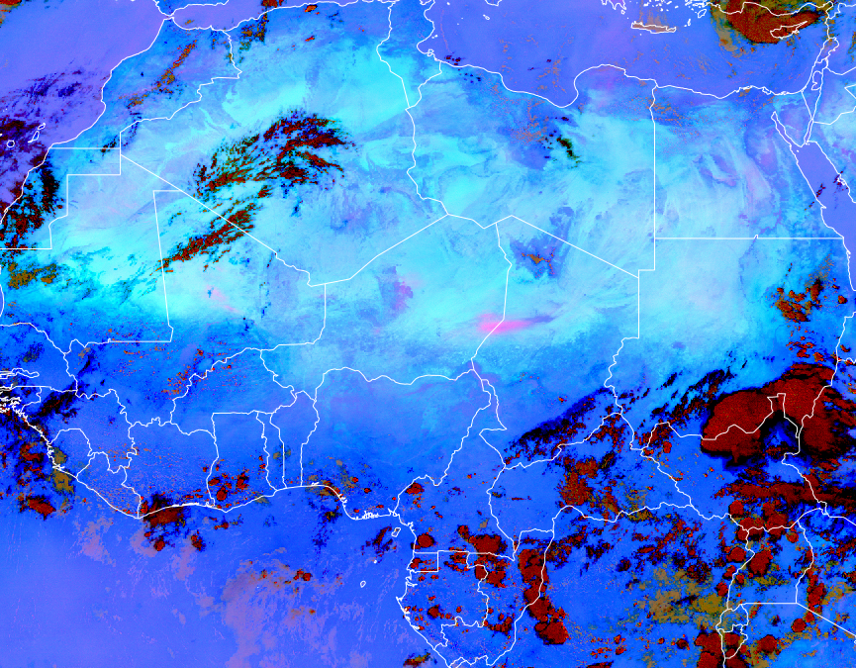
DUST

Slide 34
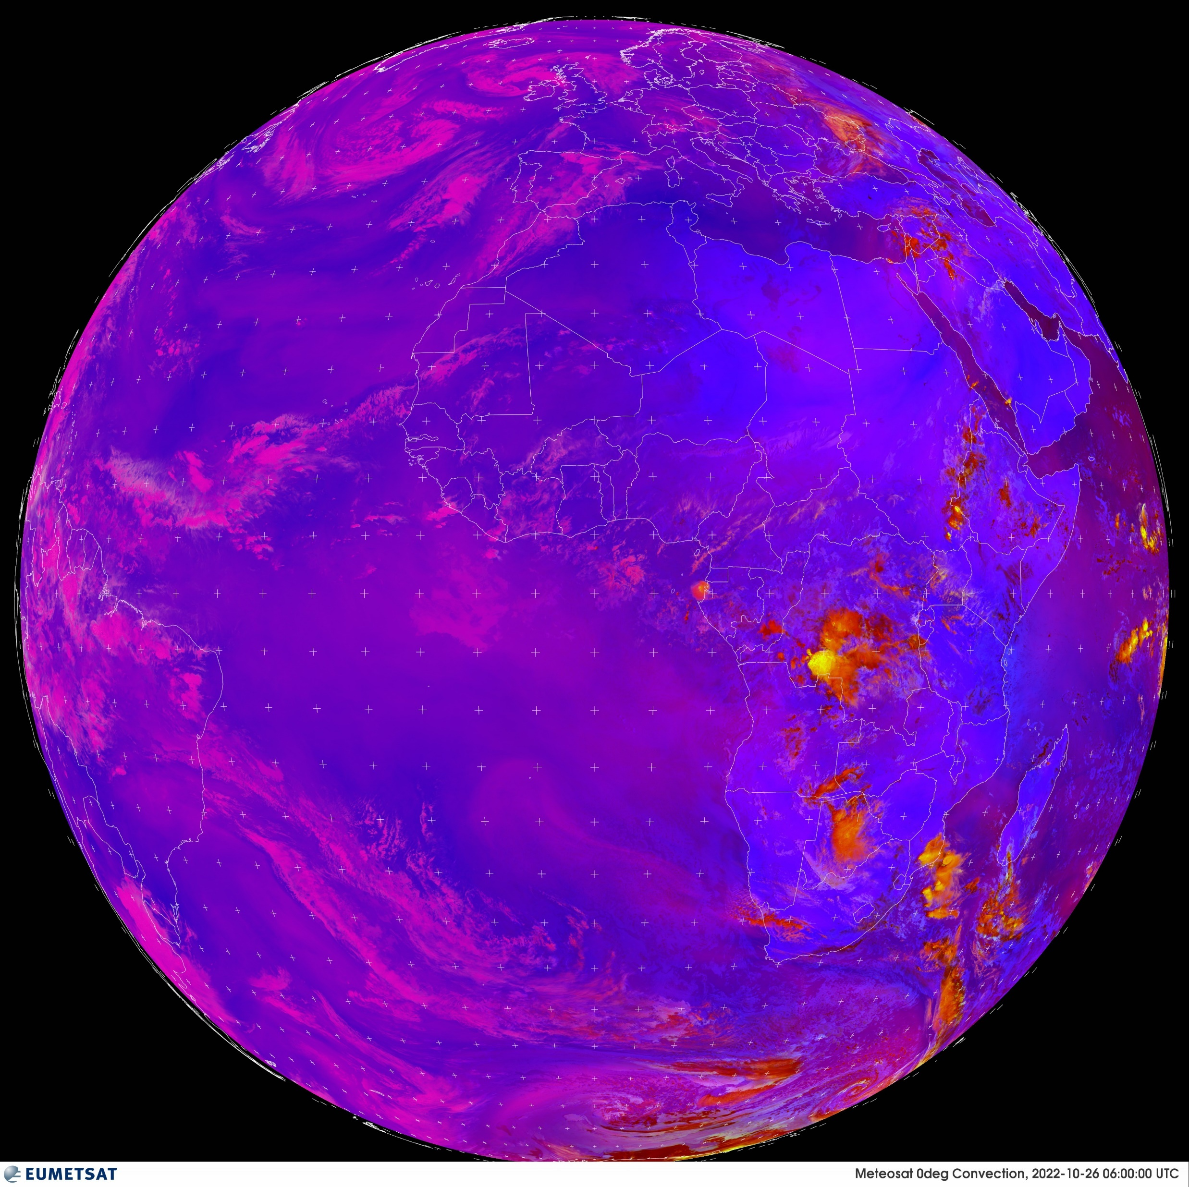
CONVECTION

Slide 35
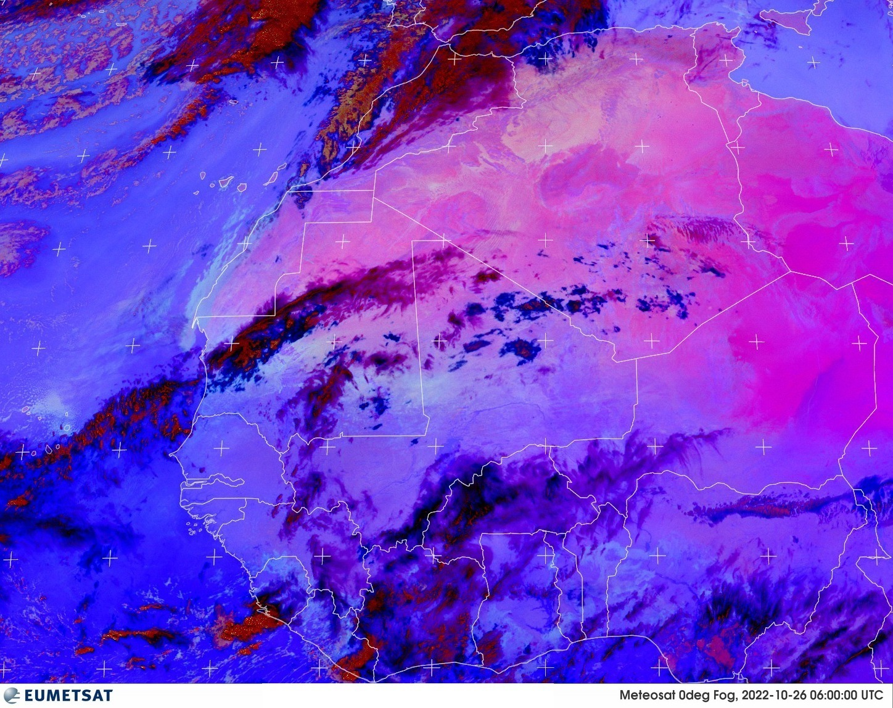
FOG

Slide 36
Satellite Sites
windy.com
view.eumetsat.int

Slide 37
Surface Verification
synop messages - www.ogimet.com
aeronautical reports - https://aviationweather.gov/metar

Slide 38
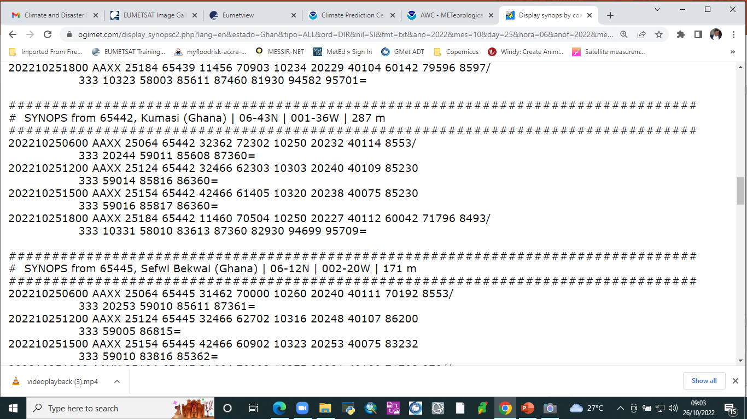
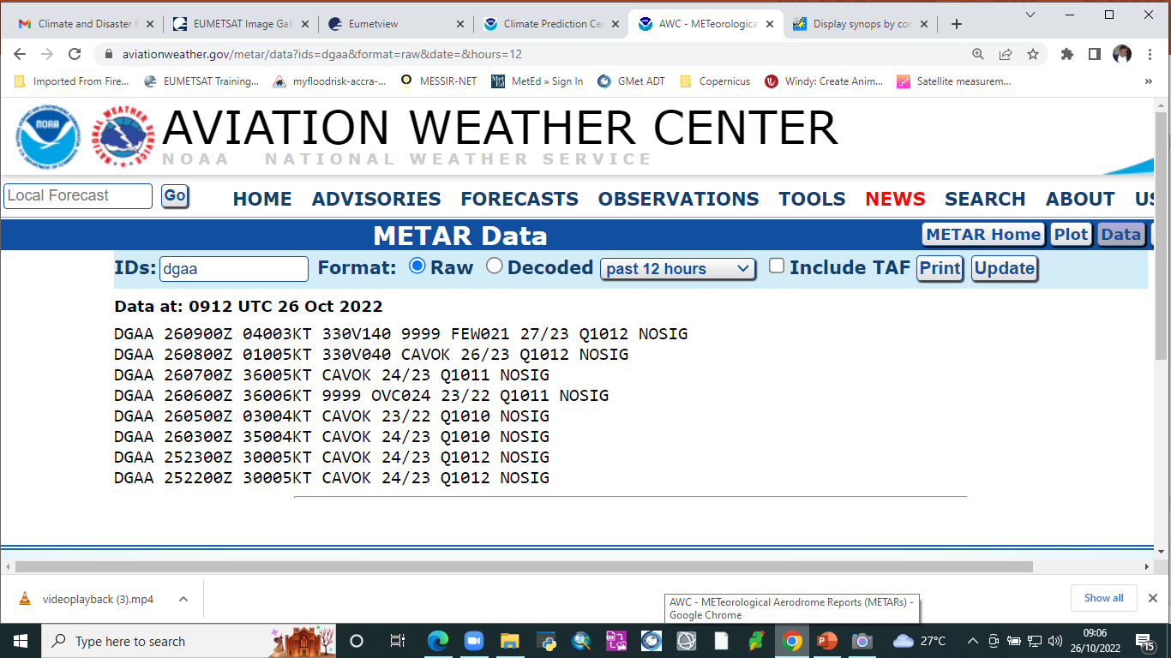
Surface Verification

Slide 39
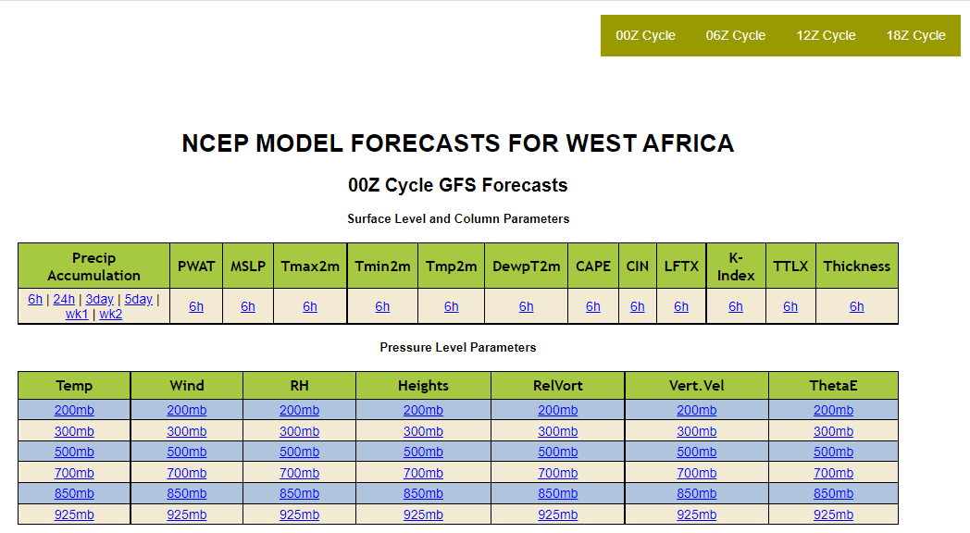

Slide 40
Point Information
Use of Tephigrams
Convergence and Divergence Fields
CAPE
Stability indices

Slide 41
Thank you

